Slide 1
Perfect Competition
Ref. Pindyck & Rubinfeld
Henderson & Quandt

Slide 2
PERFECTLY COMPETITIVE MARKETS
Assumptions:
Small but large number of sellers (and buyers);
(2) product homogeneity;
(3) free entry and exit;
(4) Perfect information on part of all economic agents;
(5) All agents are identical

Slide 3
PERFECTLY COMPETITIVE MARKETS
● price taker Firm that has no influence over market price and thus takes the price as given.
Product Homogeneity
When the products of all of the firms in a market are perfectly substitutable with one another—that is, when they are homogeneous—no firm can raise the price of its product above the price of other firms without losing most or all of its business.
● free entry (or exit) Condition under which there are no special costs that make it difficult for a firm to enter (or exit) an industry.

Slide 4
Restrictions on size and number of plants
DRS must set in.
But the optimum scale must be very small, that is, all IRS must be exhausted for a very small level of output
Each firm must operate only on one plant.

Slide 5
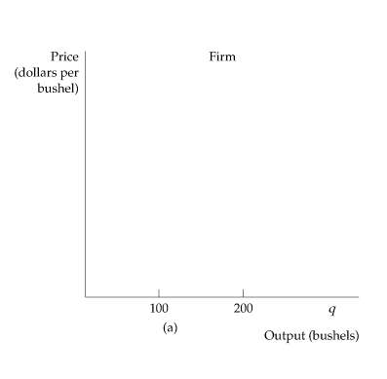
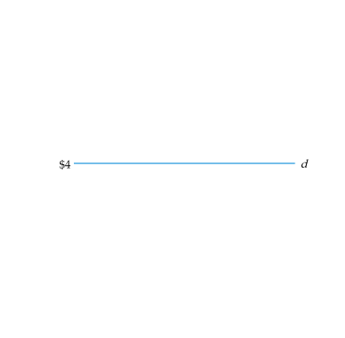
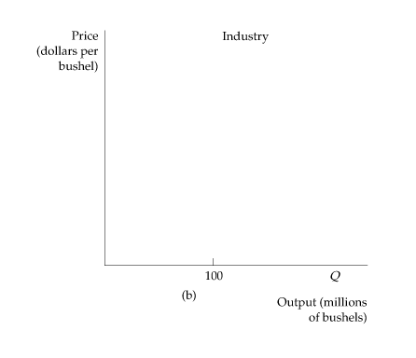
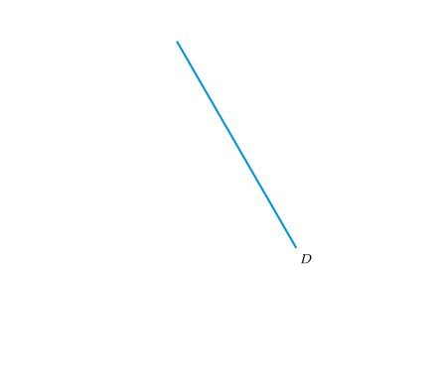
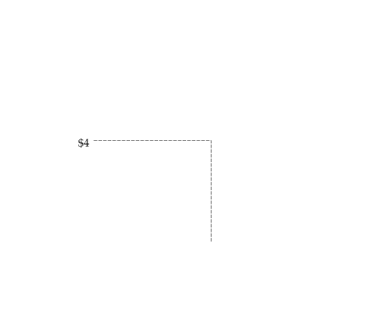
MARGINAL REVENUE, MARGINAL COST, AND PROFIT MAXIMIZATION
Demand and Marginal Revenue for a Competitive Firm
Demand Curve Faced by a Competitive Firm
A competitive firm supplies only a small portion of the total output of all the firms in an industry. Therefore, the firm takes the market price of the product as given, choosing its output on the assumption that the price will be unaffected by the output choice.
In (a) the demand curve facing the firm is perfectly elastic, even though the market demand curve in (b) is downward sloping.

Slide 6
MARGINAL REVENUE, MARGINAL COST, AND PROFIT MAXIMIZATION
Demand and Marginal Revenue for a Competitive Firm
The demand d curve facing an individual firm in a competitive market is both its average revenue curve and its marginal revenue curve. Along this demand curve, marginal revenue, average revenue, and price are all equal.
Profit Maximization by a Competitive Firm
MC(q) = MR = P

Slide 7


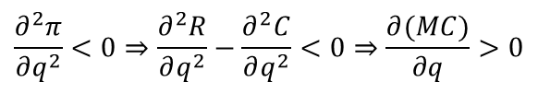
Characterization of SR eqm:
P = MR = MC at the profit-maximizing output;
$$π=TR−TC=pq−C(Q,w,y)$$
FOC
$$\frac{∂π}{∂q}=0⇒MR=MC$$
2. MC is increasing.
SOC
$$\frac{∂^{2}π}{∂q^{2}}<0⇒\frac{∂^{2}R}{∂q^{2}}−\frac{∂^{2}C}{∂q^{2}}<0⇒\frac{∂(MC)}{∂q}>0$$

Slide 8



3.
$$∀p>\min{S}ATC,π>0$$
$$∀p=\min{S}ATC,π=0$$
$$∀p<\min{S}ATC,π<0$$
4. Shut down point:
If SC = 0, F > 0, firm quits for all p < min SATC
If SC > 0, F = 0, firm quits for all p < min SAVC

Slide 9
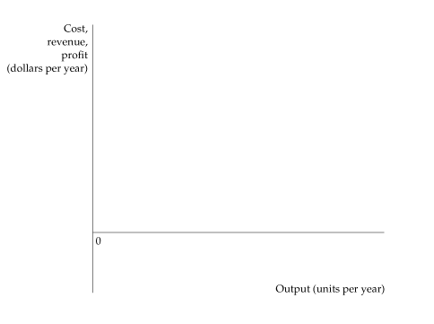
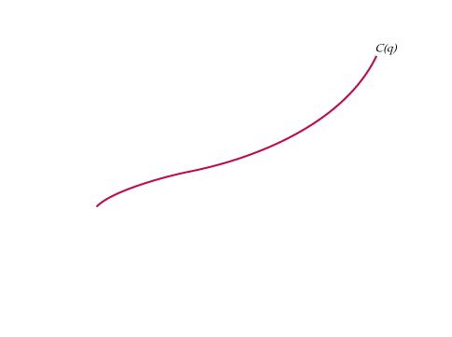
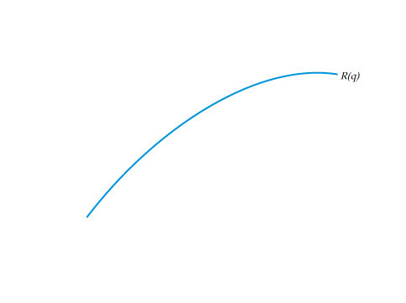
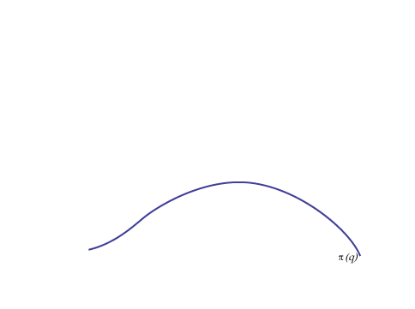
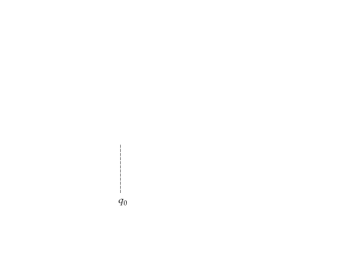
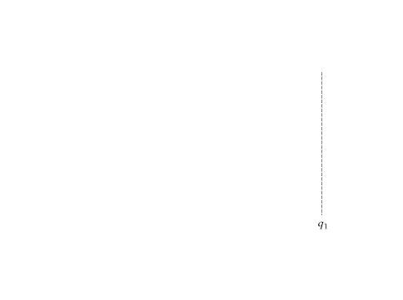
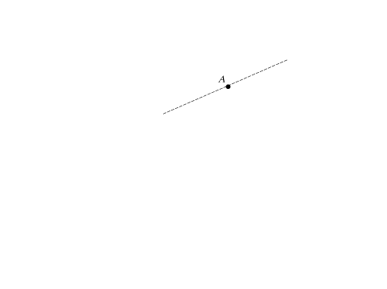
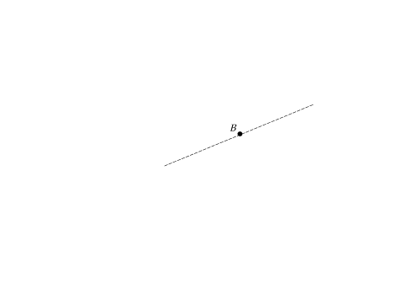
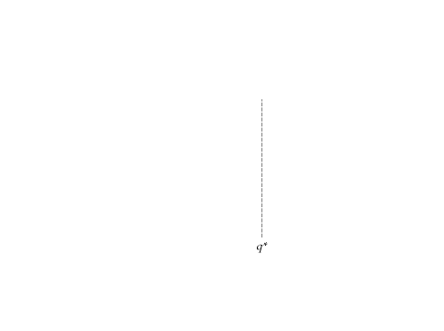
MARGINAL REVENUE, MARGINAL COST, AND PROFIT MAXIMIZATION
● profit Difference between total revenue and total cost.
π(q) = R(q) − C(q)
● marginal revenue Change in revenue resulting from a one-unit increase in output.
Profit Maximization in the Short Run
A firm chooses output q*, so that profit, the difference AB between revenue R and cost C, is maximized.
At that output, marginal revenue (the slope of the revenue curve) is equal to marginal cost (the slope of the cost curve).
Δπ/Δq = ΔR/Δq − ΔC/Δq = 0
MR(q) = MC(q)

Slide 10
CHOOSING OUTPUT IN THE SHORT RUN
Short-Run Profit Maximization by a Competitive Firm
Marginal revenue equals marginal cost at a point at which the marginal cost curve is rising.
Output Rule: If a firm is producing any output, it should produce at the level at which marginal revenue equals marginal cost.

Slide 11
SR Competitive Equilibrium
p
MC
MC
SMC
p = AR = MR
q₀
q'
q₁
q‘’
q

Slide 12

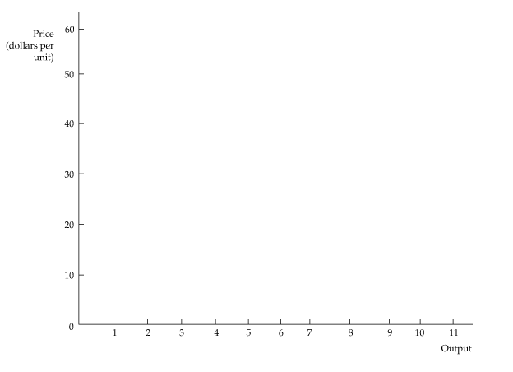
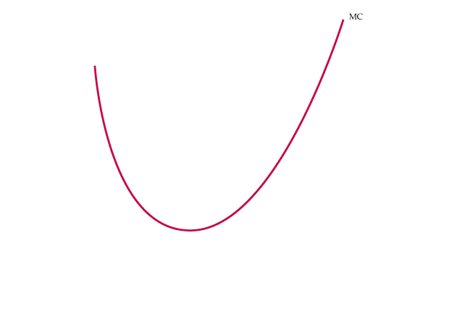


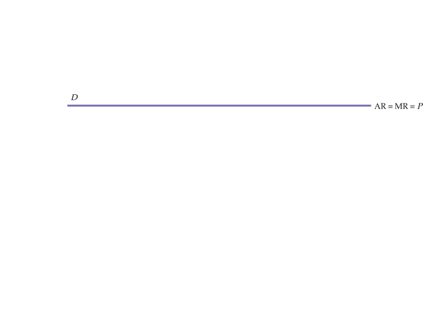
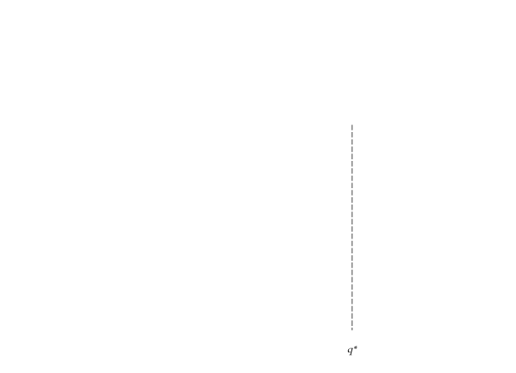
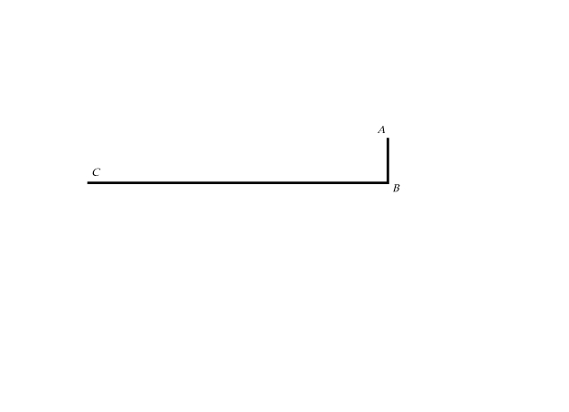
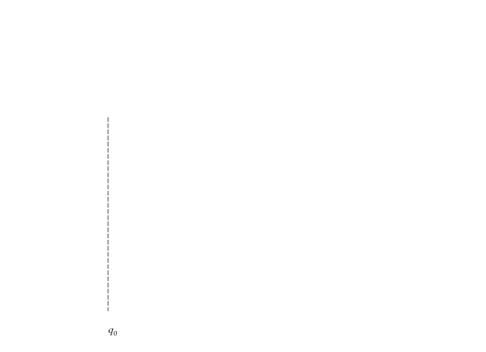
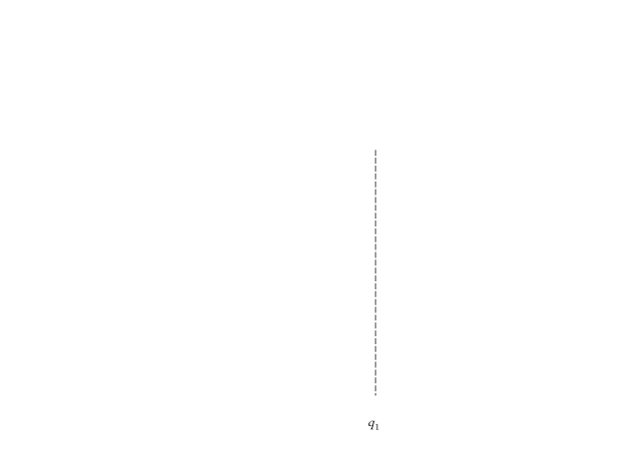
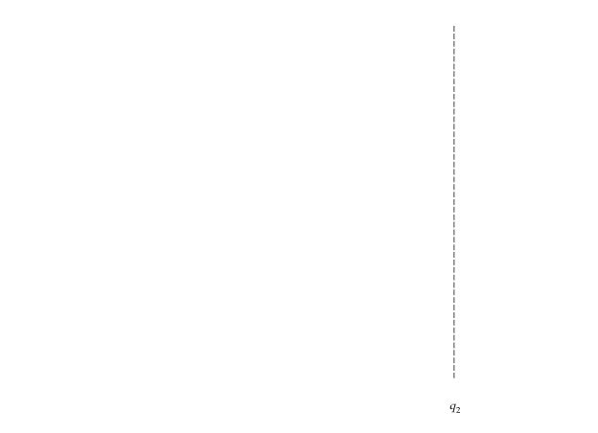
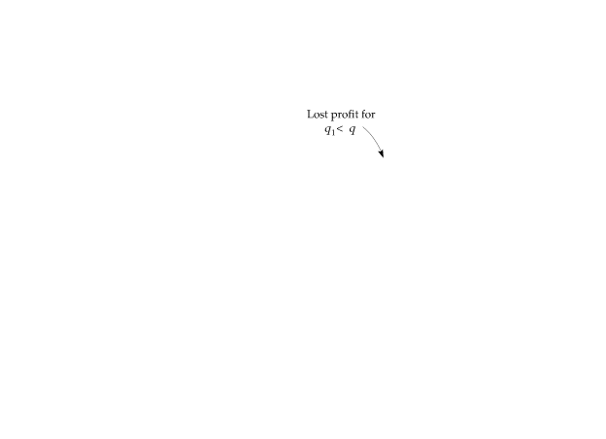
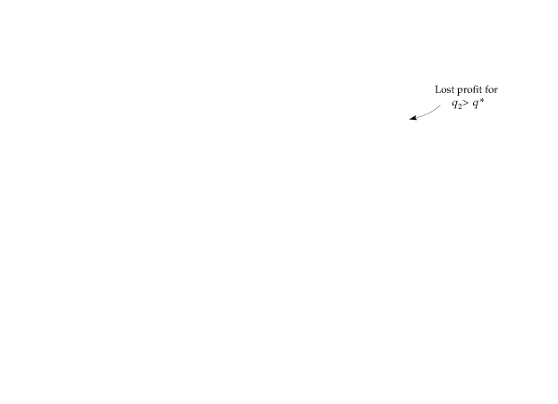

CHOOSING OUTPUT IN THE SHORT RUN
The Short-Run Profit of a Competitive Firm
A Competitive Firm Making a Positive Profit
In the short run, the competitive firm maximizes its profit by choosing an output q* at which its marginal cost MC is equal to the price P (or marginal revenue MR) of its product.
The profit of the firm is measured by the rectangle ABCD.
Any change in output, whether lower at q₁ or higher at q₂, will lead to lower profit.

Slide 13
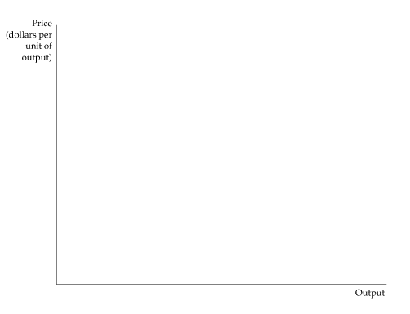
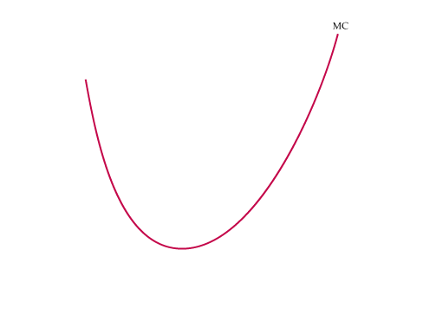


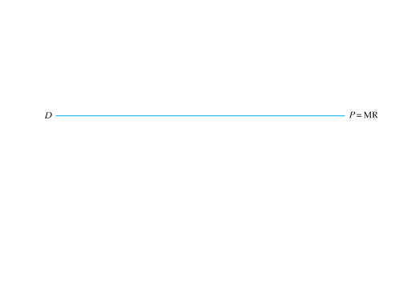
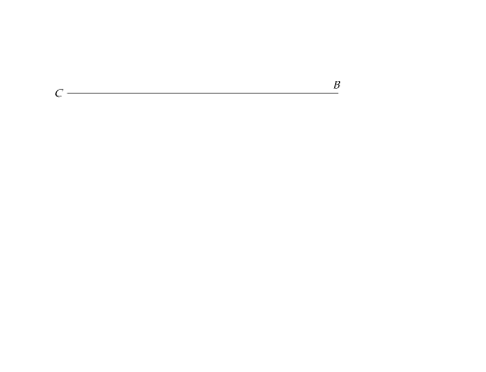
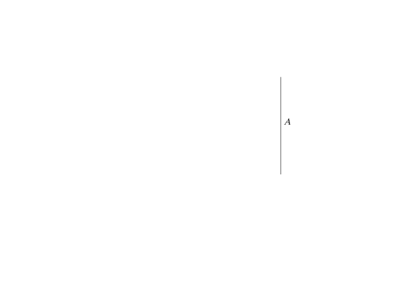

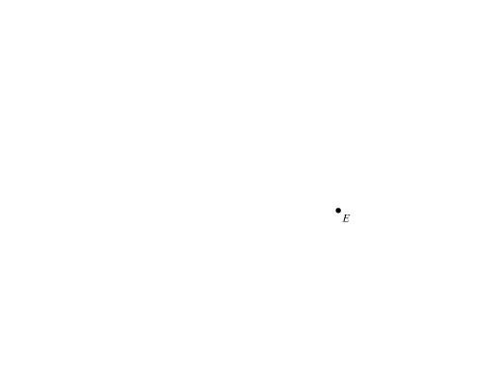
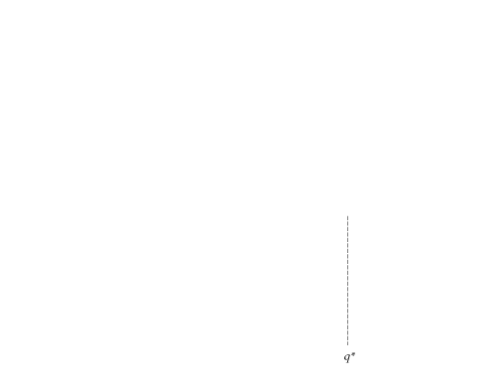
CHOOSING OUTPUT IN THE SHORT RUN
The Short-Run Profit of a Competitive Firm
A Competitive Firm Incurring Losses
A competitive firm should shut down if price is below AVC.
The firm may produce in the short run if price is greater than average variable cost.
Shut-Down Rule: The firm should shut down if the price of the product is less than the average variable cost of production at the profit-maximizing output.

Slide 14




Firm’s supply curve in SR
$$∀p>\tilde{p},P=SMC$$
$$∀p<\tilde{p},q_{s}=0$$
$$q_{s}=0∀p<\tilde{p}$$
$$q_{s}=c^{−1}′(p)∀p>\tilde{p}$$
In SR each firm may be in equilibrium but the industry is not in equilibrium.

Slide 15
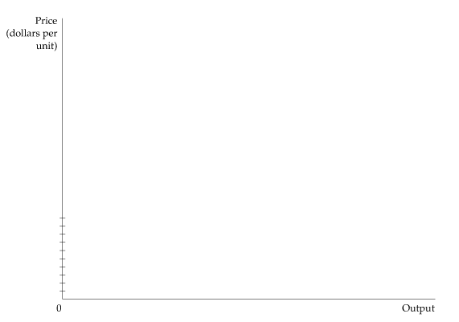
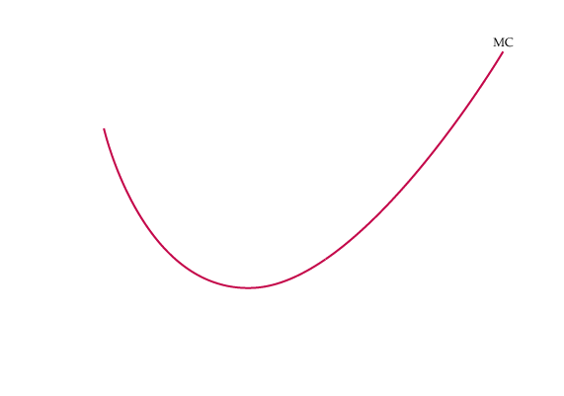
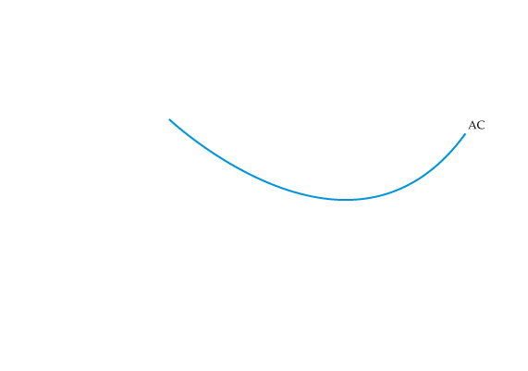
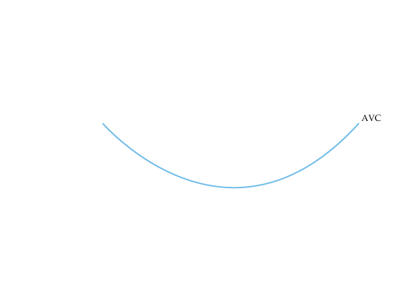
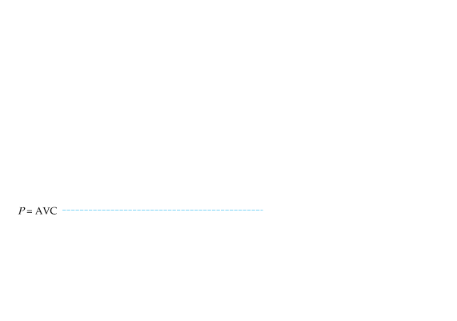
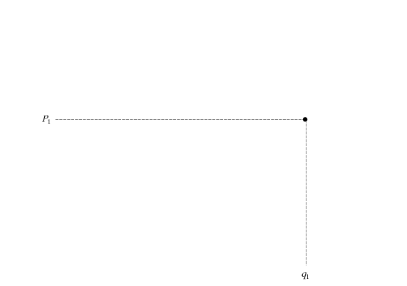
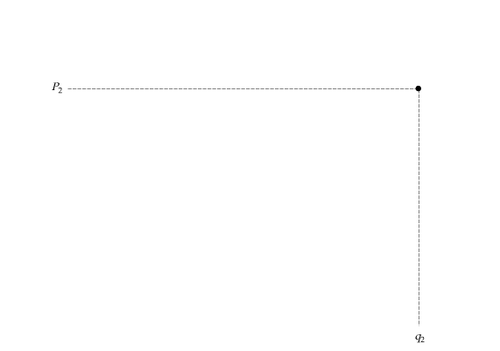

The Short-Run Supply Curve for a Competitive Firm
The firm’s supply curve is the portion of the marginal cost curve for which marginal cost is greater than average variable cost.
In the short run, the firm chooses its output so that marginal cost MC is equal to price as long as the firm covers its average variable cost.
The short-run supply curve is given by the crosshatched portion of the marginal cost curve.

Slide 16

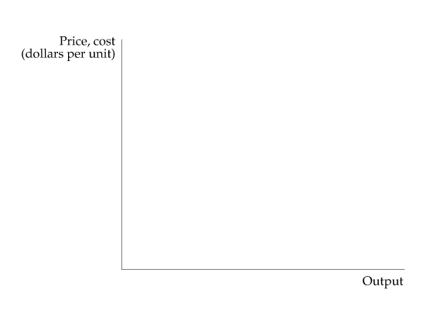
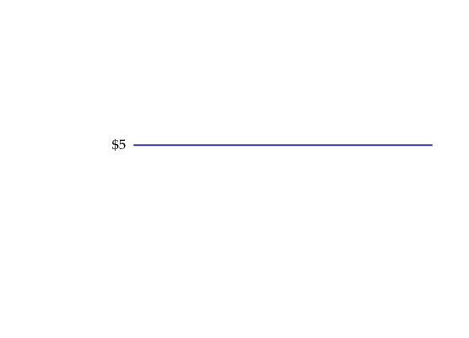
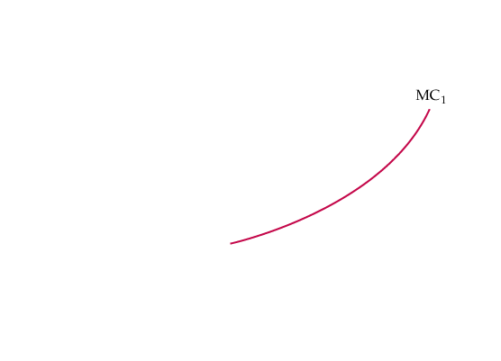
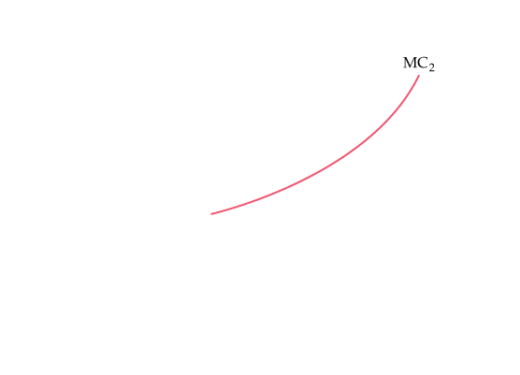
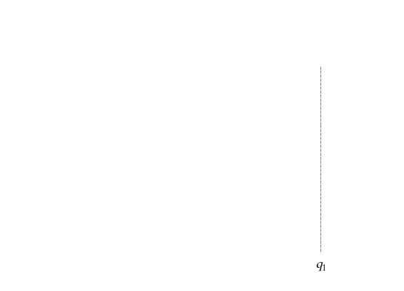
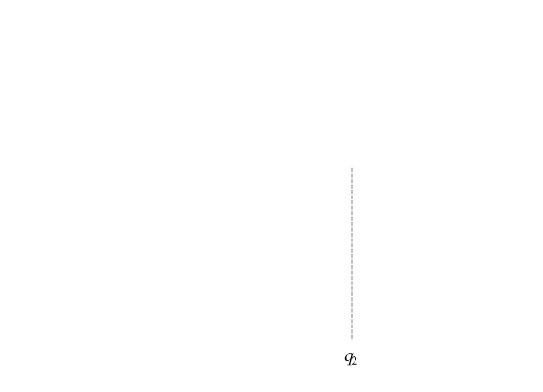
The Short-Run Profit of a Competitive Firm
The Response of a Firm to a Change in Input Price
When the marginal cost of production for a firm increases (from MC₁ to MC₂), the level of output that maximizes profit falls (from q₁ to q₂).
The shaded area in the figure gives the total savings to the firm (or equivalently, the reduction in lost profit) associated with the reduction in output from q₁ to q₂.

Slide 17
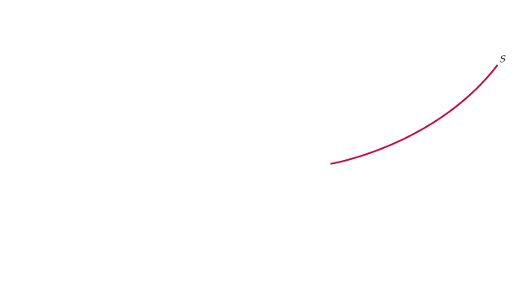
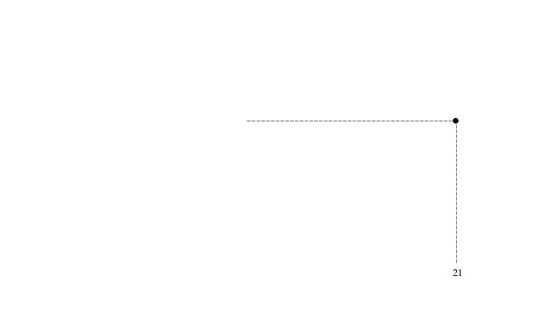
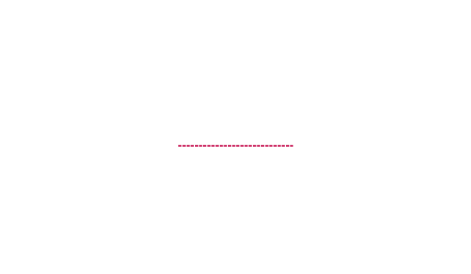
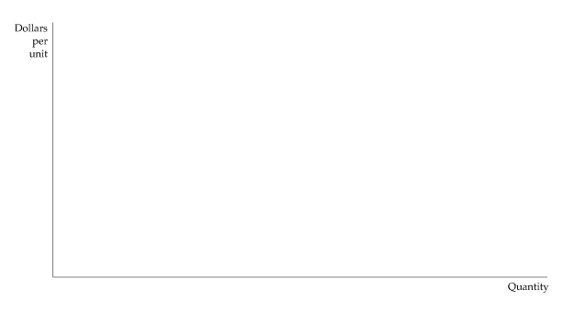
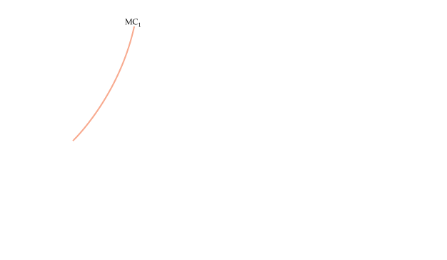










THE SHORT-RUN MARKET SUPPLY CURVE
Industry Supply in the Short Run
The short-run industry supply curve is the summation of the supply curves of the individual firms.
Because the third firm has a lower average variable cost curve than the first two firms, the market supply curve S begins at price P₁ and follows the marginal cost curve of the third firm MC₃ until price equals P₂, when there is a kink.
For P₂ and all prices above it, the industry quantity supplied is the sum of the quantities supplied by each of the three firms.
Elasticity of Market Supply
E_{s} = (ΔQ/Q)/(ΔP/P)

Slide 18








THE SHORT-RUN MARKET SUPPLY CURVE
Producer Surplus in the Short Run
● producer surplus Sum over all units produced by a firm of differences between the market price of a good and the marginal cost of production.
Producer Surplus for a Firm
The producer surplus for a firm is measured by the yellow area below the market price and above the marginal cost curve, between outputs 0 and q*, the profit-maximizing output.
Alternatively, it is equal to rectangle ABCD because the sum of all marginal costs up to q* is equal to the variable costs of producing q*.

Slide 19






THE SHORT-RUN MARKET SUPPLY CURVE
Producer Surplus in the Short Run
Producer Surplus versus Profit
Producer surplus = PS = R − VC
Profit = π = R − VC − FC
Producer Surplus for a Market
The producer surplus for a market is the area below the market price and above the market supply curve, between 0 and output Q*.

Slide 20













CHOOSING OUTPUT IN THE LONG RUN
Long-Run Profit Maximization
Output Choice in the Long Run
The firm maximizes its profit by choosing the output at which price equals long-run marginal cost LMC.
In the diagram, the firm increases its profit from ABCD to EFGD by increasing its output in the long run.
The long-run output of a profit-maximizing competitive firm is the point at which long-run marginal cost equals the price.

Slide 21




LR Adjustment
P,C
P
SMC₁
$S\left(\text{n}\text{0} \right)= \sum_{i=1}^{n_{0}}{{SMC}_{i}}$
D
SAC₁
SMC*
LAC
$$\sum_{i=1}^{n_{0}}{{SMC}_{i}}$$
P₀
P₀
$$\sum_{i=1}^{n∗}{{SMC}_{i}}$$
$$\overline{P}$$
q₀
q*
q’’
q’
q
n₀q₀
= Q₀
n₀q’’
= Q’’
n*q*
= Q*
Q

Slide 22
CHOOSING OUTPUT IN THE LONG RUN
Long-Run Competitive Equilibrium
Accounting Profit and Economic Profit
π = R − wL − rK
Zero Economic Profit
● zero economic profit A firm is earning a normal return on its investment—i.e., it is doing as well as it could by investing its money elsewhere.

Slide 23












CHOOSING OUTPUT IN THE LONG RUN
Long-Run Competitive Equilibrium
Entry and Exit
Long-Run Competitive Equilibrium
Initially the long-run equilibrium price of a product is $40 per unit, shown in (b) as the intersection of demand curve D and supply curve S₁.
In (a) we see that firms earn positive profits because long-run average cost reaches a minimum of $30 (at q₂).
Positive profit encourages entry of new firms and causes a shift to the right in the supply curve to S₂, as shown in (b).
The long-run equilibrium occurs at a price of $30, as shown in (a), where each firm earns zero profit and there is no incentive to enter or exit the industry.

Slide 24
CHOOSING OUTPUT IN THE LONG RUN
Long-Run Competitive Equilibrium
Entry and Exit
In a market with entry and exit, a firm enters when it can earn a positive long-run profit and exits when it faces the prospect of a long-run loss.
● long-run competitive equilibrium All firms in an industry are maximizing profit, no firm has an incentive to enter or exit, and price is such that quantity supplied equals quantity demanded.
A long-run competitive equilibrium occurs when three conditions hold:
All firms in the industry are maximizing profit.
2. No firm has an incentive either to enter or exit the industry because all firms are earning zero economic profit.
3. The price of the product is such that the quantity supplied by the industry is equal to the quantity demanded by consumers.

Slide 25




Long run equilibrium:
P=LAC=LMC=SAC=SMC
Profit=0 (zero economic proft)
Profit maximization condition:
$$π=TR−TC=pq−c(q) \\ π=0⇒pq=c(q)⇒p=\frac{c(q)}{q}=AC$$
$$π=π(n)=π(q,n)$$
$$D=S(n)⇒n$$
Set
$$π(q,n)=0$$
Get n*

Slide 26













CHOOSING OUTPUT IN THE LONG RUN
Producer Surplus in the Long Run
Firms Earn Zero Profit in Long-Run Equilibrium
In long-run equilibrium, all firms earn zero economic profit.
In (a), a baseball team in a moderate-sized city sells enough tickets so that price ($7) is equal to marginal and average cost.
In (b), the demand is greater, so a $10 price can be charged. The team increases sales to the point at which the average cost of production plus the average economic rent is equal to the ticket price.
When the opportunity cost associated with owning the franchise is taken into account, the team earns zero economic profit.

Slide 27














THE INDUSTRY’S LONG-RUN SUPPLY CURVE
● constant-cost industry Industry whose long-run supply curve is horizontal.
In (b), the long-run supply curve in a constant-cost industry is a horizontal line S_{L}.
When demand increases, initially causing a price rise (represented by a move from point A to point C),
the firm initially increases its output from q₁ to q₂, as shown in (a).
But the entry of new firms causes a shift to the right in industry supply.
Because input prices are unaffected by the increased output of the industry, entry occurs until the original price is obtained (at point B in (b)).
The long-run supply curve for a constant-cost industry is, therefore, a horizontal line at a price that is equal to the long-run minimum average cost of production.

Slide 28

















● increasing-cost industry: Industry whose long-run supply curve is upward sloping.
Long-Run Supply in an Increasing-Cost Industry
In (b), the long-run supply curve in an increasing-cost industry is an upward-sloping curve S_{L}.
When demand increases, initially causing a price rise,
the firms increase their output from q₁ to q₂ in (a).
In that case, the entry of new firms causes a shift to the right in supply from S₁ to S₂.
Because input prices increase as a result, the new long-run equilibrium occurs at a higher price than the initial equilibrium.
In an increasing-cost industry, the long-run industry supply curve is upward sloping.

Slide 29
Remark
Long run supply curve is not related to Returns to scale. Even with CRS throughout, the LRS can be upward rising/ downward sloping.
Shape of LRS depends on the impact of output change on input price.
hence, shape of LRS is external to the firm.

Slide 30
Special Case: CRS throughout
P,C
For example: If the TC fn is C=ϴQ, determine the number of firms on the LR.
Here LAC= LMC=ϴ = p.
q*Є [0, D(ϴ)]
Cannot determine the number of firms.
Perfect Indeterminacy of perfect competition (Samuelson)
q

